Slide 1

Starbucks Reviews Sentiment Analysis:
Unveiling Customer Insights
This report provides a comprehensive overview and evaluation of the "Starbucks Reviews Sentiment Analysis" project. Leveraging the power of data science, this initiative delves into customer feedback to extract meaningful insights, showcasing robust data processing, natural language processing (NLP), and sophisticated data visualization skills.
The project's meticulous approach to analyzing customer sentiment offers valuable lessons in understanding public perception and actionable strategies for business improvement.

Slide 2
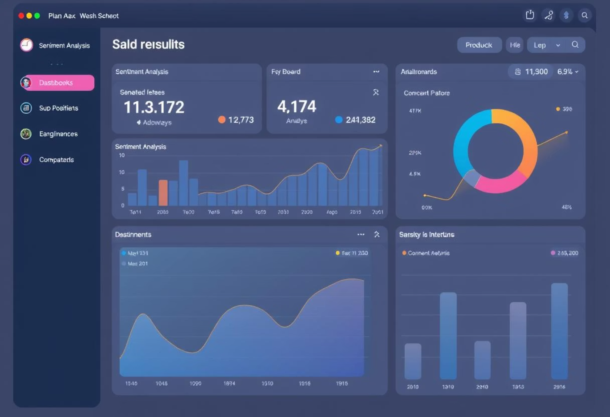
Project Overview and Core Objectives
The "Starbucks Reviews Sentiment Analysis" project was initiated to gain a deeper understanding of customer feedback by systematically analyzing review data. The primary objective was to quantify sentiment, identify recurring themes, and visualize key insights that could inform business decisions.
This involved a multi-stage process, starting from raw review data and progressing through various analytical techniques to yield actionable intelligence. The project serves as a testament to the power of data-driven approaches in enhancing customer experience and operational efficiency within the food and beverage industry.

Slide 3
Robust Data Preprocessing and Cleaning
A cornerstone of accurate sentiment analysis lies in the thorough preprocessing and cleaning of raw data. This project meticulously handled various aspects of data preparation, ensuring the integrity and usability of the dataset.
1
Missing Value Management
2
Data Transformation
3
Text Cleaning
Effectively addressed and dropped null values to maintain data quality and prevent skewed analysis results.
Renamed columns for clarity, converted data types (e.g., 'Rating' to int64), and extracted granular information such as 'City' from location data, parsing 'Date' into 'Month', 'Year', and 'DayOfWeek' for temporal analysis.
Implemented a dedicated clean function to preprocess review text. This involved converting text to lowercase, removing URLs, HTML tags, punctuation, and numbers, crucially utilizing NLTK for stopwords removal and stemming to standardize vocabulary for accurate sentiment analysis.

Slide 4

Effective Sentiment Analysis with TextBlob
The project successfully employed TextBlob, a powerful Python library, for conducting sentiment analysis. This tool allowed for the efficient calculation of sentiment polarity and the subsequent classification of reviews.
TextBlob was instrumental in assigning a sentiment polarity score to each customer review. Based on these scores, reviews were categorized into 'Positive', 'Neutral', or 'Negative' using predefined thresholds. This classification provides a clear, quantitative measure of overall customer sentiment, enabling rapid identification of trends and areas of concern.
This systematic approach to sentiment categorization ensures consistency and provides a reliable foundation for subsequent data visualizations and actionable insights.

Slide 5
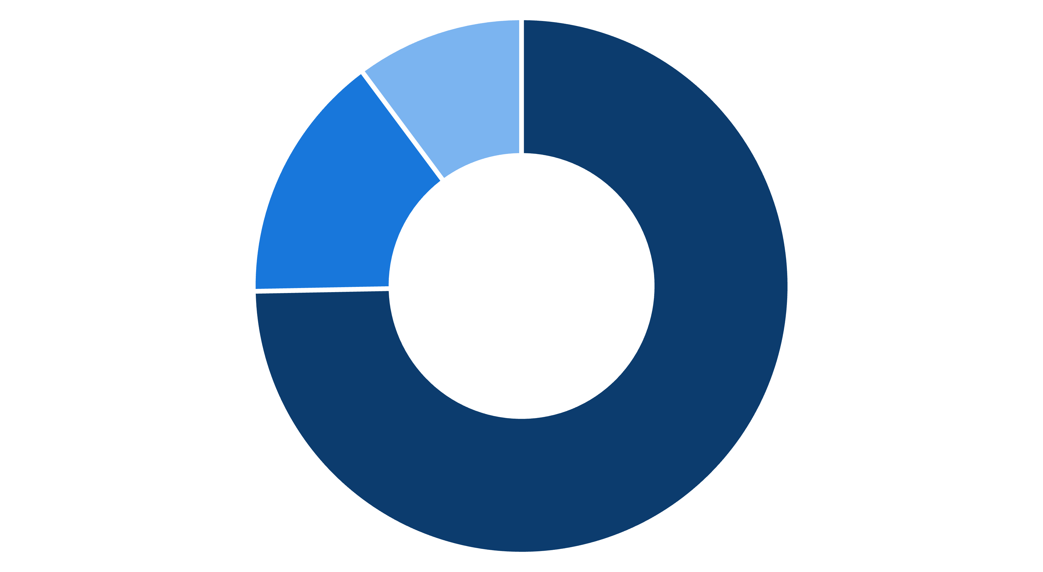
Distribution of Customer Sentiments
Understanding the overall sentiment distribution is crucial for assessing customer satisfaction. The project provides clear insights into the proportion of positive, neutral, and negative reviews.
Positive
Neutral
Negative
The donut chart illustrates that a significant majority of Starbucks reviews are positive, indicating a generally favorable customer experience. While neutral and negative sentiments are present, their smaller proportions suggest specific areas for improvement rather than widespread dissatisfaction.

Slide 6
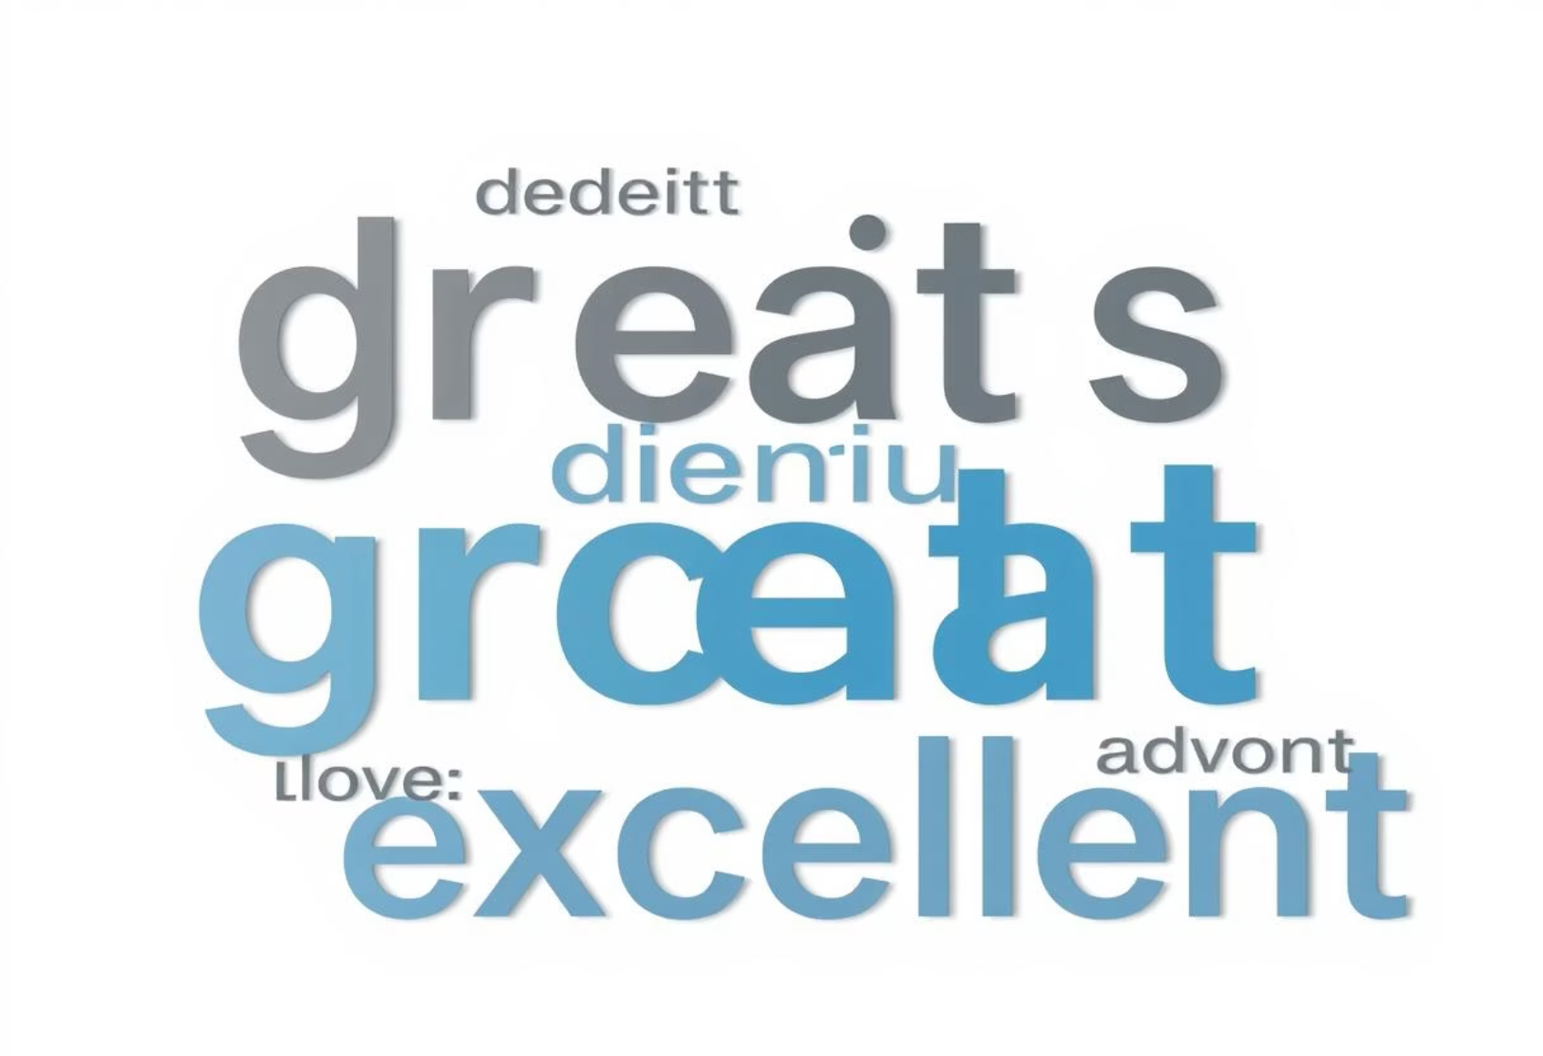
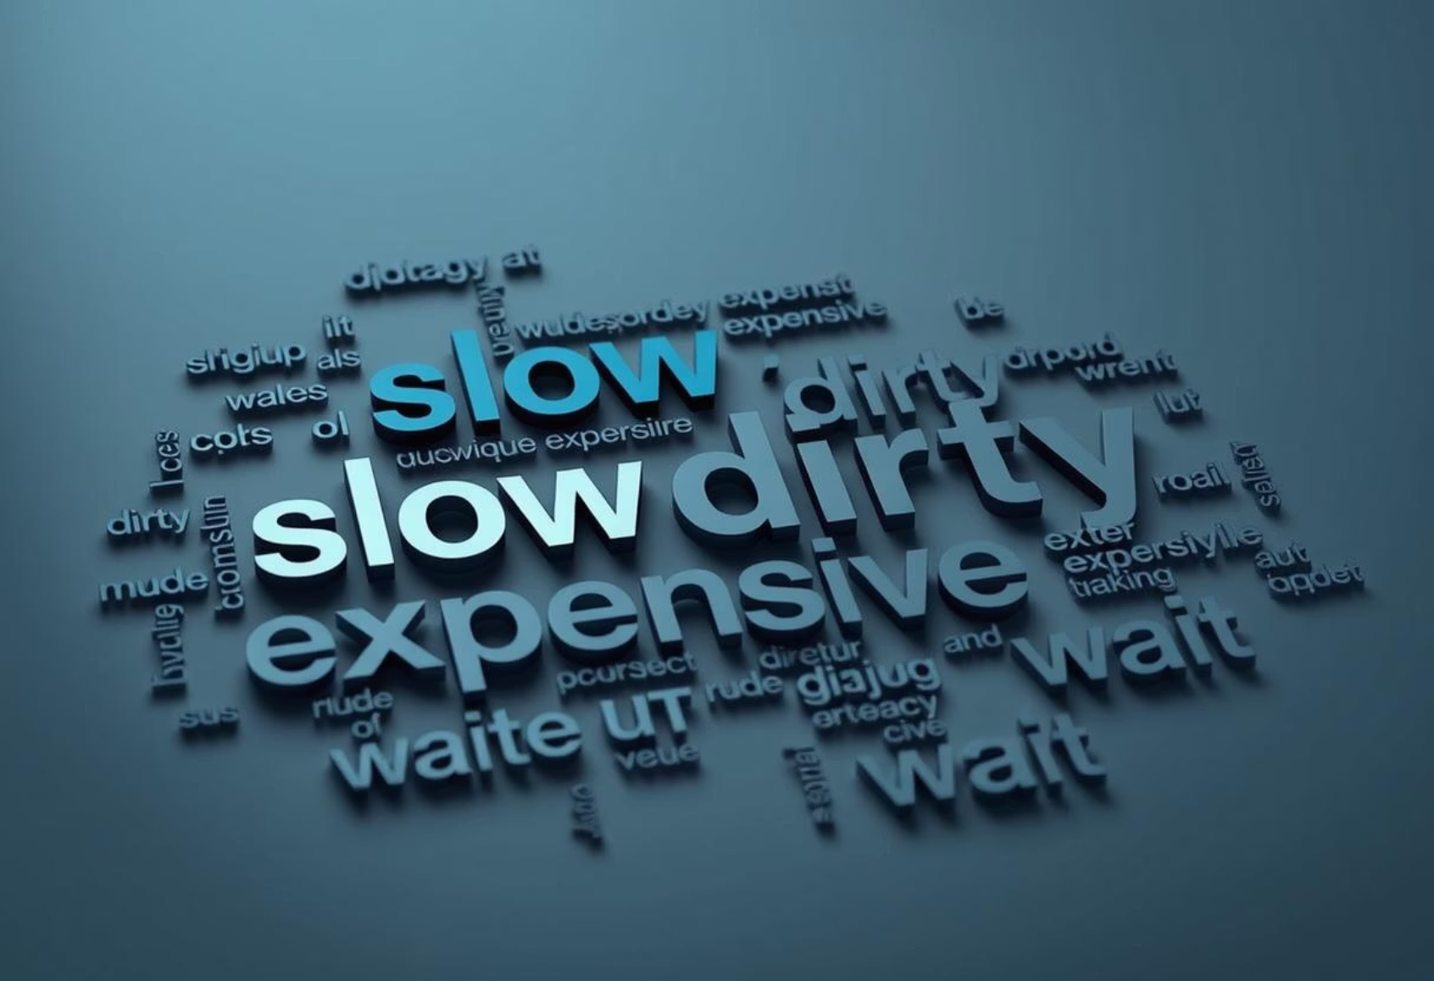
Visualizing Key Themes with Word Clouds
Word clouds offer an immediate and intuitive visual representation of the most frequently used terms within different sentiment categories. This allows for quick identification of recurring themes and dominant topics in customer feedback.
Positive Word Cloud
Negative Word Cloud
This word cloud highlights common positive terms, such as "delicious," "friendly," and "excellent," providing direct insight into what customers appreciate most about their Starbucks experience.
Conversely, this word cloud for negative reviews reveals words like "slow," "dirty," and "expensive," pinpointing specific pain points that require attention and operational adjustments.

Slide 7



In-Depth Issue Analysis and Rating Correlation
Beyond general sentiment, the project provides sophisticated visualizations that delve into specific issues and their relationship with customer ratings. This granular analysis is critical for targeted problem-solving.
Identifying Key Issues
A treemap effectively visualizes the distribution of identified issues within Starbucks reviews, highlighting the most prevalent problems reported by customers, such as "long wait times" or "unclean stores."
Issues & Rating Correlation
A stacked bar chart brilliantly demonstrates how different issues correlate with various customer ratings. For instance, it might show that "rude staff" frequently leads to 1-star ratings, while "slow service" might result in 3-star ratings, allowing for a deeper understanding of specific problem areas and their impact.

Slide 8
Recommendations for Starbucks Based on Sentiment Analysis
Enhance Customer Service TrainingInvest in regular training programs for baristas to ensure consistent friendliness and accuracy in orders.
Strengthen Feedback LoopsEncourage more customers to leave reviews and create a system to respond to them effectively.
Improve Product ConsistencyAddress common complaints regarding product taste and quality, especially for seasonal launches.
Boost Positive ExperiencesRecognize and reward employees who are frequently mentioned positively in reviews to motivate excellence.
Monitor High-Risk LocationsUse sentiment insights to identify branches with recurring negative feedback and take corrective actions.

Slide 9
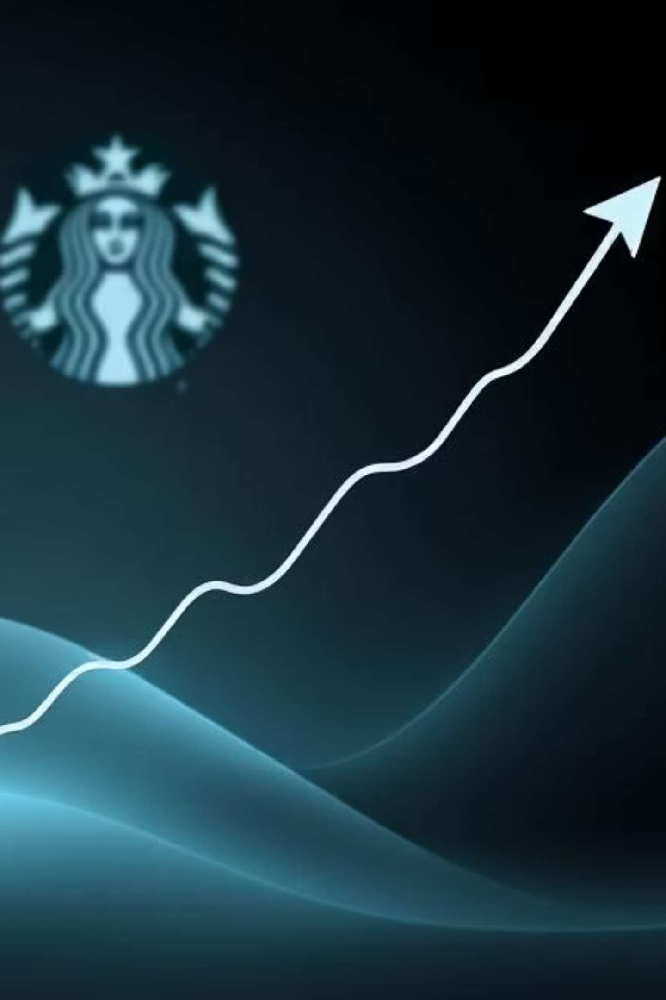
Conclusion: Actionable Insights for Improvement
The Starbucks Reviews Sentiment Analysis project is a well-structured and thoughtfully executed analysis. It effectively combines data manipulation, NLP techniques, and compelling visualizations to extract meaningful and actionable insights from customer reviews.
The project highlights a strong understanding of data science methodologies and the ability to present complex findings in an accessible manner. The insights gained, such as predominant positive sentiment tempered by specific operational concerns, provide a clear roadmap for Starbucks to enhance customer experience, refine service delivery, and ultimately drive continued success.

